Slide 1
UML
Unified Modeling Language

Slide 2
UML
UML is a away to use diagrams to visualize a system or database.
It’s use frequently to plan out software systems.

Slide 3
UML: Why?
UML stands for Unified Modeling Language which according to the legend was developed when some serious IT people were fed up with an ambiguous variety of circles, dashes, stars and clouds.
Graphical modeling languages have been around in the software industry for a long time . The fundamental driver behind them all is that programming languages are not at a high enough level of abstraction to facilitate discussions about design.

Slide 4
UML: What?
The UML is a family of graphical notations, backed by single meta-model, that help in describing and designing software systems, particularly software systems built using the object-oriented (OO) style .
UML 2.0 consists of an integrated set of diagrams of various agreed shapes and forms designed to help system and software developers to define, design, visualize and document software system artifacts and in some cases some business models.
UML is a set of best engineering practices that has proven to be effective in modeling large and complex systems and is a very important part of object-oriented software development.

Slide 5
UML: How?
UML mainly uses graphical notation to express the software project’s design. So it helps teams to communicate explore potential designs and validate software architectural designs.

Slide 6
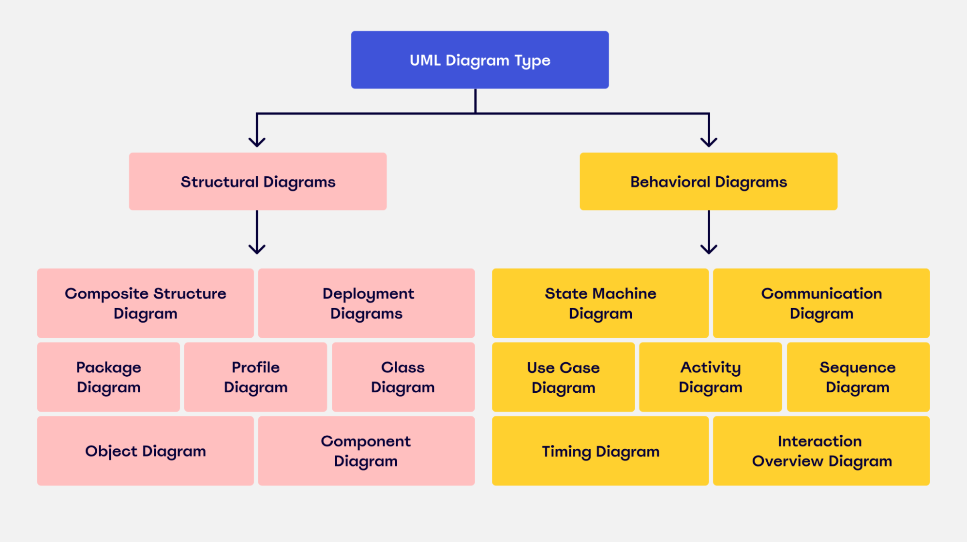
UML Diagram Type
UML diagrams can be divided into two main types:
Structural Diagrams
Behavioral Diagrams

Slide 7
Structural Diagrams

Slide 8
UML: Class Diagram
Class diagram is the central modeling technique that is used in almost all object oriented methods.
This diagram describes the types of the objects in the system and different kinds of static relationships that exists between them.
If someone were to come up to you in a dark alley and say, "Psst, want to see a UML diagram?" that diagram would probably be a class diagram .
Note! The UML uses the term feature as a general term that covers properties and operations of a Class .

Slide 9
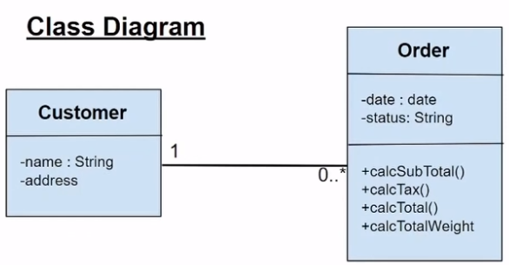
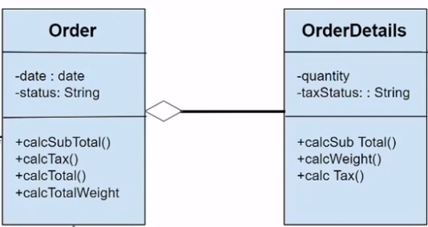
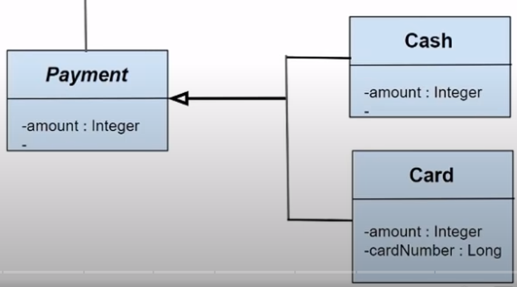
Class Diagram
The boxes are divided into three compartments :
The name of the class (in bold)
Its attributes
Its operations
Three most important types of relationships in class diagrams:
Association: Represents relationships between instances of types
e.g. Person works for a company or a company has multiple offices.
Generalization: Corresponds directly to inheritance in object oriented design.
Aggregation: A form of object composition in object oriented design.

Slide 10
Class Diagram: Properties
Properties represent structural features of a Class . As a first approximation, you can think of properties as corresponding to fields in a Class .
Properties are a single concept, but they appear in two quite distinct notations :
Attributes
Associations
Notes
In general, Attributes use for Small things, such as dates or Booleans-in general, value types - and associations for more significant classes, such as customers and orders .
Although attributes ad associations look quite different on a diagram, they are really the same thing .

Slide 11
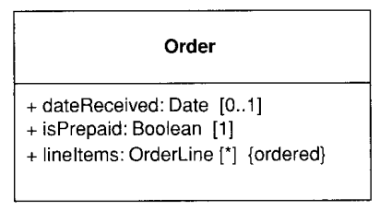
Class Diagram: Properties -> Attributes
1. Attributes : Describes a property as a line of text within the class box itself
The full UML Syntax for Attributes is :
visibility name : type multiplicity{collection-options} = default {property-string*}
e.g. name : String [1] = "Untitled" {readOnly}
lineItems: OrderLine[*] {ordered}
Showing properties of an order as attributes
Note
* Property string can be : readOnly , modifiable :default

Slide 12
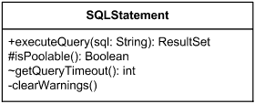
Class Diagram: Visibility
Each language makes its own rules . Although many languages use such terms as Public, private, and protected and etc.
However, the UML provides four abbreviations for visibility :
+ : public
- : private
~ : package
# : protected
Note
Visibility of the operation is optional.

Slide 13
Class Diagram: Multiplicity
The multiplicity of a property is an indication of how many objects may fill the property.
collection-type : multiplicity-range { collection-options }
The most common multiplicities you will see are:
1 (An order must have exactly one customer .)
0. .1 (A corporate customer may or may not have a single sales rep.)
* (A customer need not place an Order and there is no upper limit to the number of Orders a Customer may place-zero or more orders .)
In attributes, you come across various terms that refer to the multiplicity.
Optional implies a lower bound od 0.
Mandatory implies a lower bound of 1 or possibly more.
Single-values implies an upper bound of 1.
Multivalued implies an upper bound of more than 1: usually *.
Using a plural form for multivalued property for its name, properly .

Slide 14
Class Diagram: Multiplicity -> Constraint
Multiplicity options could also specify of whether the values in an instantiation of the element should be unique and/or ordered:
{ordered}: If multiplicity element is multivalued and specified as ordered, then the collection of values in an instantiation of this element is sequentially ordered. By default, collections are not ordered.
{unique}: If multiplicity element is multivalued and specified as unique, then each value in the collection of values in an instantiation of this element must be unique. By default, each value in collection is unique.
{nonunique}: If you want to allow duplicates.
{unordered}: By default, collections are not ordered.
{bag}: you may also see collection-oriented names, such as {bag} for unordered , nonunique.
Note
By default, collections are not ordered.
If you want to explicitly show the default, you can use unordered and unique -> {unordered, unique}.

Slide 15
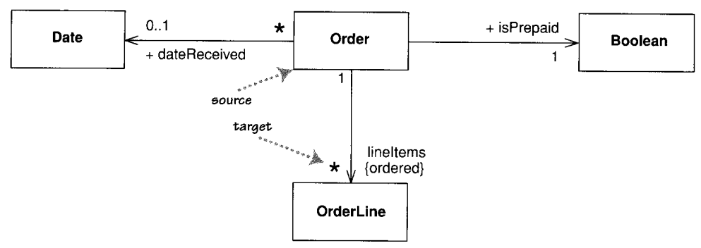
Class Diagram: Properties -> Associations
2. Associations: An association is a solid line between two classes. The name of the property goes at the target end of the association, together with its multiplicity .
Sometimes you use class boxes for classes that are significant for the diagram, which leads to using associations (orderLine), and attributes for things less important for that diagram(orderLine in Prev page). The choice is much more about emphasis than about any underlying meaning .
Showing properties of an order as associations

Slide 16
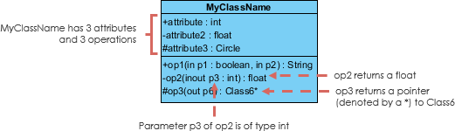
Class Diagram: Operations
The full UML Syntax for operations is :
visibility name (parameter-list) : return-type {property-string*}
The parameters in the parameter list are notated in a similar way to attributes . The form is :
direction name : type = default value
e.g. balance0n (date : Date) : Money
Notes
* The Property string can be: query , modifiers , getting method , setting method
The direction indicates whether the parameter is input (in), output (out) or both (inout) . If no direction is shown, it's assumed to be in .
With conceptual models, you shouldn't use operations to specify the Interface of a class . An operation is something that is invoked an an object-the procedure declaration-whereas a method is the body of a procedure .

Slide 17
Class Diagram: Operations-> Direction
in : An input Parameter (may not be modified).If no direction is shown, it’s assumed to be in.
out : An output Parameter (may be modified to communicate information to the caller).
inout : An input Parameter that may be modified.
return : A return value of a call.

Slide 18
Relationship Types
Dependency: also called a using relationship, which means, one class is dependent on another class.
Generalization / Inheritance: also called an "is-a-kind-of" relationship.
e.g. A Corporate Customer is a special kind of Customer.
Association: also called a "has-a" relationship that says one class is somehow associated with another class. e.g. Student and Teacher relationship.
Aggregation is the same as association but with an additional point that there is an ownership of the instances, unlike association where there was no ownership of the instances. e.g. A Teacher and Department relationship.(A Teacher instance can only belong to one Department instance)
Composition This is the same as that of aggregation, but with the additional point that the lifetime of the child instance is dependent on the owner or the parent class instance. A e.g. Department and University relationship.
Specialization is the reverse process of Generalization means creating new sub-classes from an existing class.
Note
Association is a special kind of relationship and is sub-divided into the two specialized concepts of Aggregation and Composition.
The Generalization is linked with displaying the inheritances while the association shows the linking based on commonalities.
Generalization and inheritance are the same. The terminology just differs depending on the context where it is being used.

Slide 19
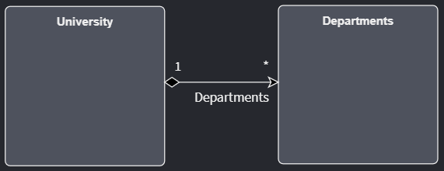
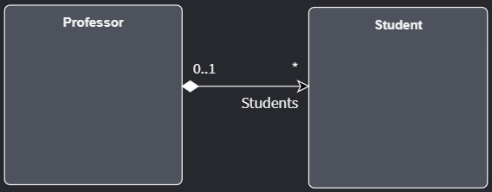
Association Types
Association types are used to describe the ownership between Entities.
Composition Relationship
When attempting to represent real-world whole-part relationships, e.g. an engine is a part of a car.
When the container is destroyed, the contents are also destroyed, e.g. a university and its departments.
Aggregation relationship
When representing a software or database relationship, e.g. car model engine ENG01 is part of a car model CM01, as the engine, ENG01, may be also part of a different car model.
When the container is destroyed, the contents are usually not destroyed, e.g. a professor has students; when the professor dies the students do not die along with them.

Slide 20
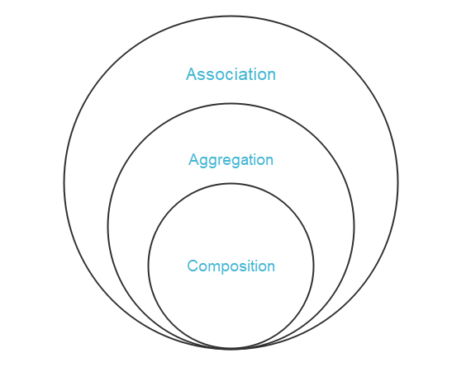
Aggregation .vs Composition
Aggregation | Composition
A subset of association | A subset of aggregation.
A weak type of association. | A strong type of association
Linked objects are independent of each other. | Linked objects are highly dependent on each other.
Represented with a solid line and an empty arrowhead. | Represented by a solid line with a filled arrowhead.
Aggregation is defined as a ‘has-a’ relationship. | Composition is defined as a ‘part-of’ relationship.
Note: Composition is stronger than aggregation. A relationship between two objects is cited as an association, and both of these terms are a sub-type of it.

Slide 21
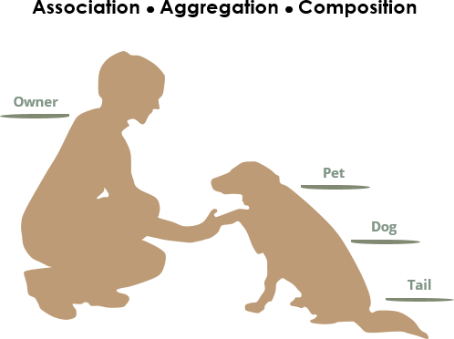
Class Diagram: Relationship Types -> Sample
We see the following relationships:
owners feed pets, pets please owners (association)
a tail is a part of both dogs and cats (aggregation / composition)
a cat is a kind of pet (inheritance / generalization)
https://www.linkedin.com/pulse/aggregation-composition-amit-nadiger/
https://www.visual-paradigm.com/guide/uml-unified-modeling-language/uml-aggregation-vs-composition/
https://www.c-sharpcorner.com/UploadFile/b1df45/dependency-generalization-association-aggregation-compos/

Slide 22

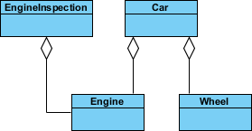
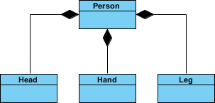


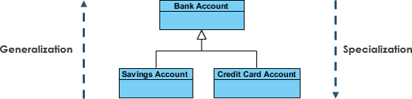
Class Diagram: Relationship Types-> Sample

Slide 23
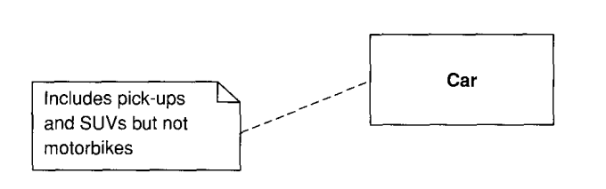
Notes and Comments
They can appear in any kind of diagram .
Notes can stand an their own, or they can be linked with a dashed line to the elements they are commenting .
Sometimes, it's useful to have an in-line comment an a diagram element . You can do this by prefixing the text with two dashes : -- .
note is used as a comment an one or more diagram elements

Slide 24
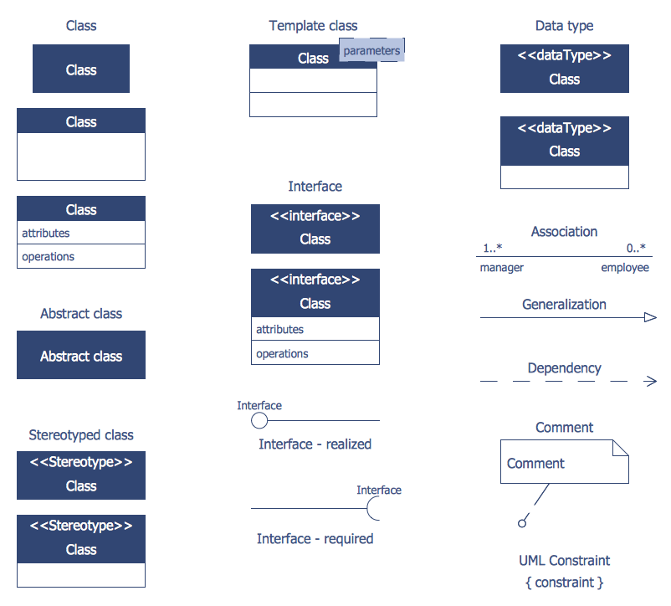
Design Elements- UML Class Diagram

Slide 25
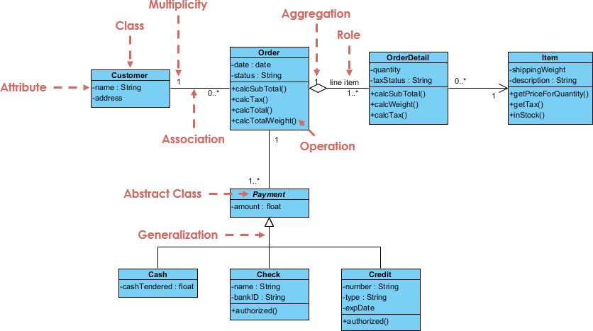
Class Diagram: Sample -> Order System

Slide 26
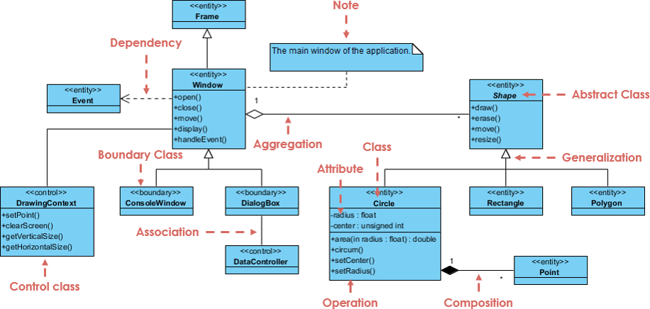
Class Diagram: Sample -> GUI

Slide 27
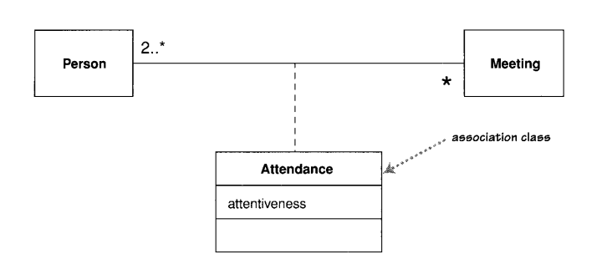
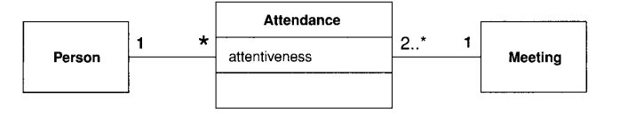
Association Class
Association classes allow you to add attributes, operations, and other features to associations.
What benefit do you gain which the association class to Offset the extra notation you have to remember?
The association class adds an extra constraint, in that there can be only one instance of the association class between any two participating objects .
Association class promoting an association class to a full class

Slide 28
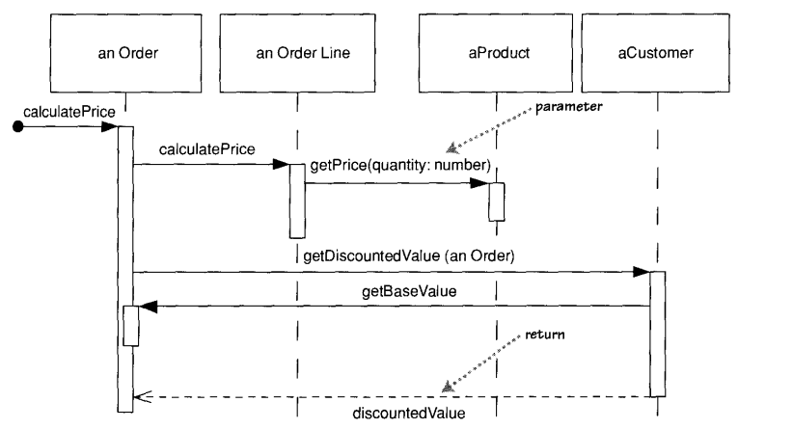
Sequence Diagram
The UML defines several forms of interaction diagram, of which the most common is the sequence diagram.
Typically, a sequence diagram captures the behavior of a single scenario. The diagram shows a number of example objects and the messages that are passed between these objects within the use case .
1. Centralized control
2. Distributed control
A sequence diagram for distributed control

Slide 29
Sequence Diagram Notation
Sequence Diagram Notation
Actors
Lifelines
Messages
Create message
Delete Message
Self Message
Reply Message
Found Message
Lost Message
Guards
https://www.geeksforgeeks.org/unified-modeling-language-uml-sequence-diagrams/
https://creately.com/guides/sequence-diagram-tutorial/
https://www.conceptdraw.com/How-To-Guide/bank-sequence-diagram
https://www.conceptdraw.com/solution-park/software-atm-uml-diagrams

Slide 30
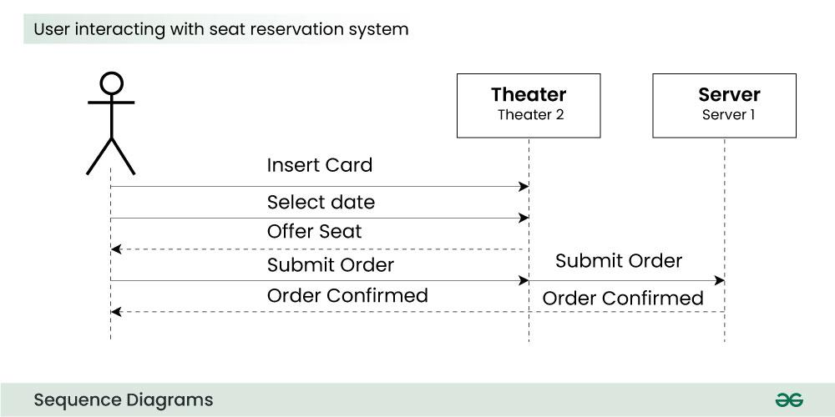
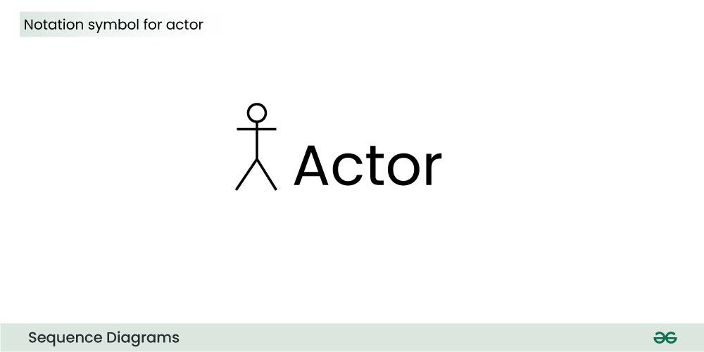
Sequence Diagram Notation: Actors
1.1. Actors
An actor in a UML diagram represents a type of role where it interacts with the system and its objects. It is important to note here that an actor is always outside the scope of the system we aim to model using the UML diagram.
We use actors to depict various roles including human users and other external subjects. We represent an actor in a UML diagram using a stick person notation. We can have multiple actors in a sequence diagram.
For example : Here the user in seat reservation system is shown as an actor where it exists outside the system and is not a part of the system.

Slide 31
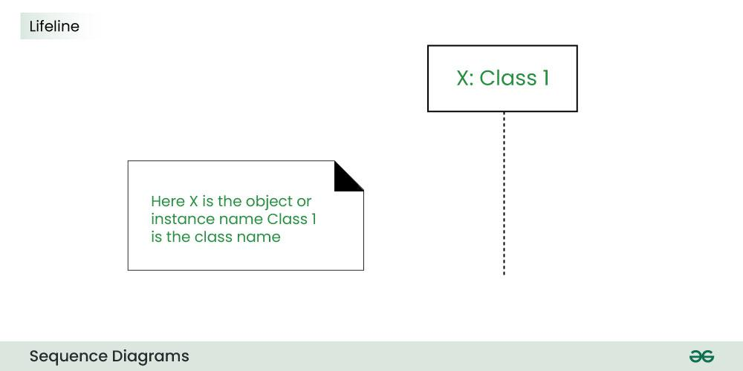
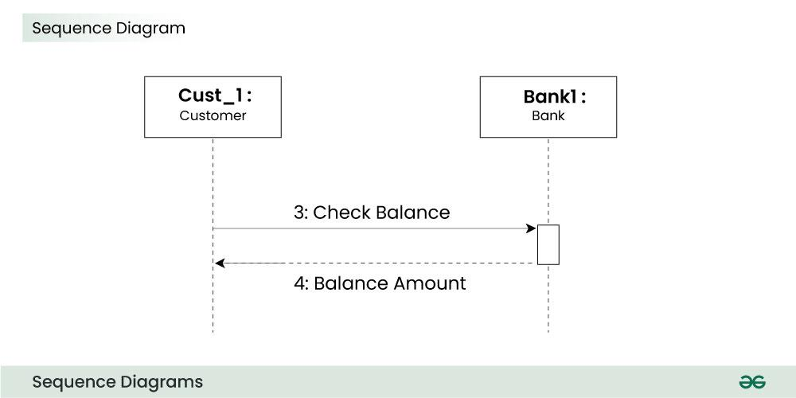
Sequence Diagram Notation: Lifelines
1.2. Lifelines
A lifeline is a named element which depicts an individual participant in a sequence diagram. So basically each instance in a sequence diagram is represented by a lifeline. Lifeline elements are located at the top in a sequence diagram. The standard in UML for naming a lifeline follows the following format:
Instance Name : Class Name
Note: A lifeline always portrays an object internal to the system whereas actors are used to depict objects external to the system.

Slide 32
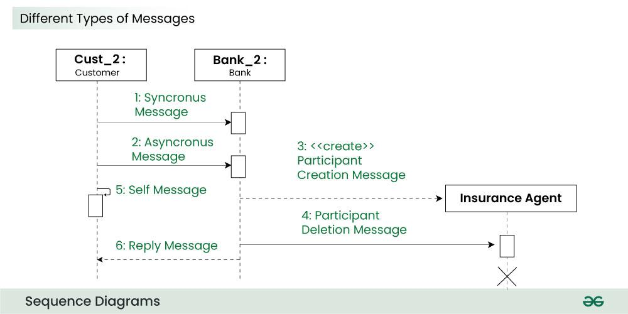
Sequence Diagram Notation: Messages
1.3. Messages
Communication between objects is depicted using messages. The messages appear in a sequential order on the lifeline.
We represent messages using arrows.
Lifelines and messages form the core of a sequence diagram.

Slide 33
Sequence Diagram Notation: Messages
Messages can be broadly classified into the following categories:
Synchronous Messages
Asynchronous Messages

Slide 34
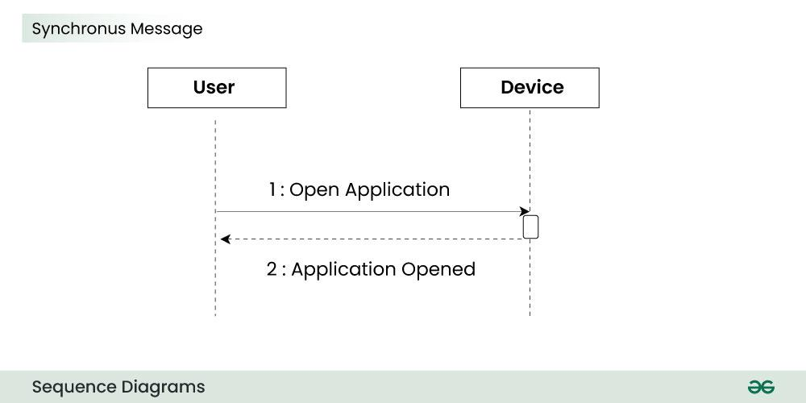
Sequence Diagram Notation: Messages
Synchronous Messages
A synchronous message waits for a reply before the interaction can move forward. The sender waits until the receiver has completed the processing of the message. The caller continues only when it knows that the receiver has processed the previous message i.e. it receives a reply message.
A large number of calls in object oriented programming are synchronous.
We use a solid arrow head to represent a synchronous message.

Slide 35
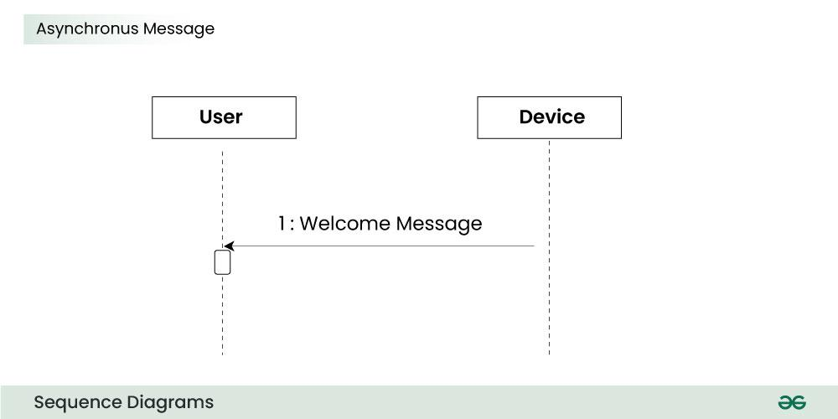
Sequence Diagram Notation: Messages
Asynchronous Messages
An asynchronous message does not wait for a reply from the receiver. The interaction moves forward irrespective of the receiver processing the previous message or not. We use a lined arrow head to represent an asynchronous message.

Slide 36
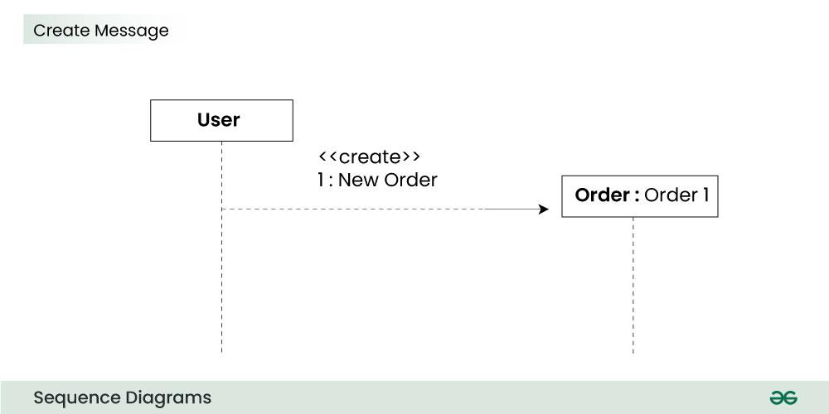
Sequence Diagram: Create Message
1.4. Create message
We use a Create message to instantiate a new object in the sequence diagram. There are situations when a particular message call requires the creation of an object. It is represented with a dotted arrow and create word labelled on it to specify that it is the create Message symbol.
For example: The creation of a new order on a e-commerce website would require a new object of Order class to be created.

Slide 37
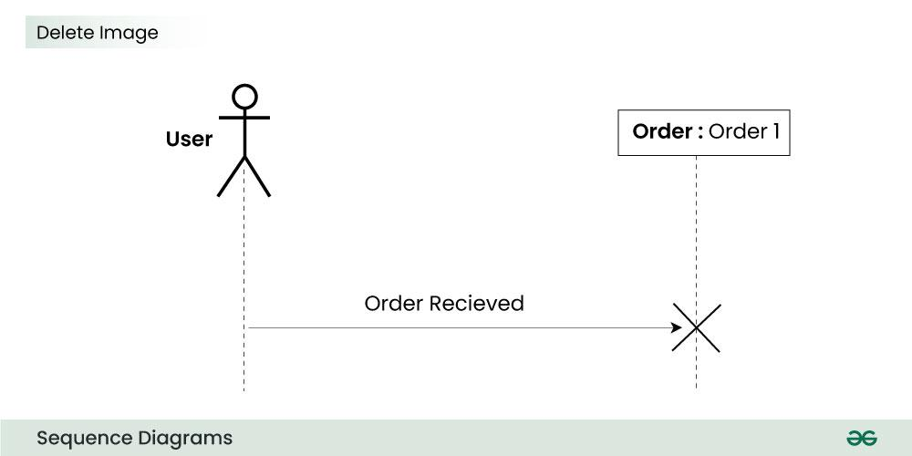
Sequence Diagram: Delete Message
1.5. Delete Message
We use a Delete Message to delete an object. When an object is deallocated memory or is destroyed within the system we use the Delete Message symbol. It destroys the occurrence of the object in the system. It is represented by an arrow terminating with a x.
For example: In the scenario below when the order is received by the user, the object of order class can be destroyed.

Slide 38
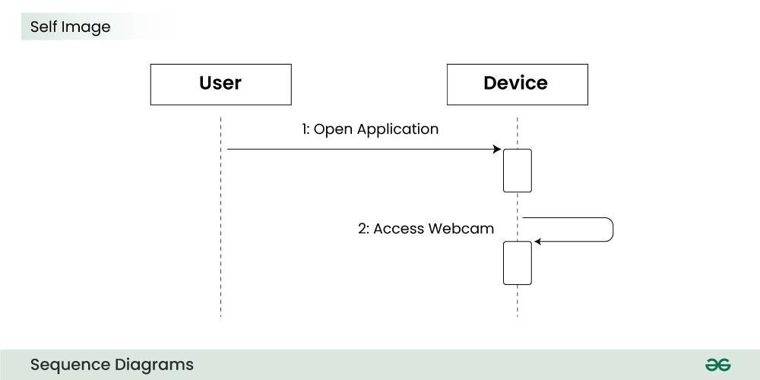
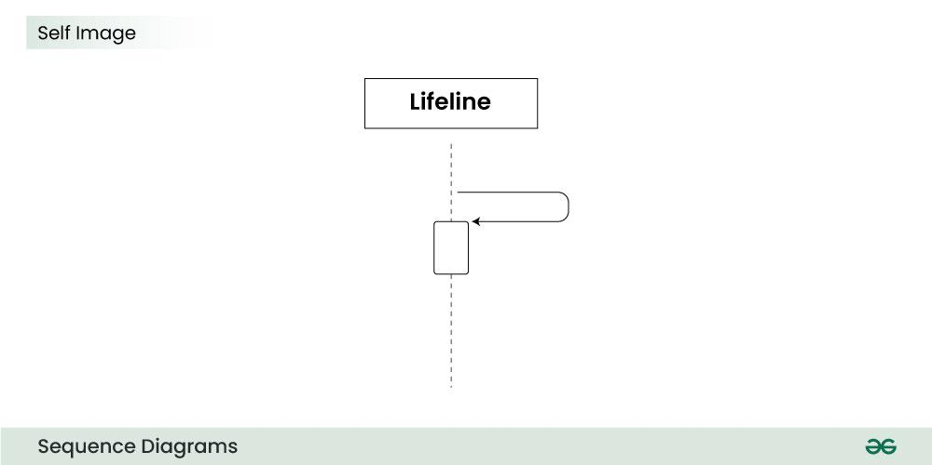
Sequence Diagram: Self Message
1.6. Self Message
Certain scenarios might arise where the object needs to send a message to itself. Such messages are called Self Messages and are represented with a U shaped arrow.
For example: Consider a scenario where the device wants to access its webcam.
Such a scenario is represented using a self message.

Slide 39
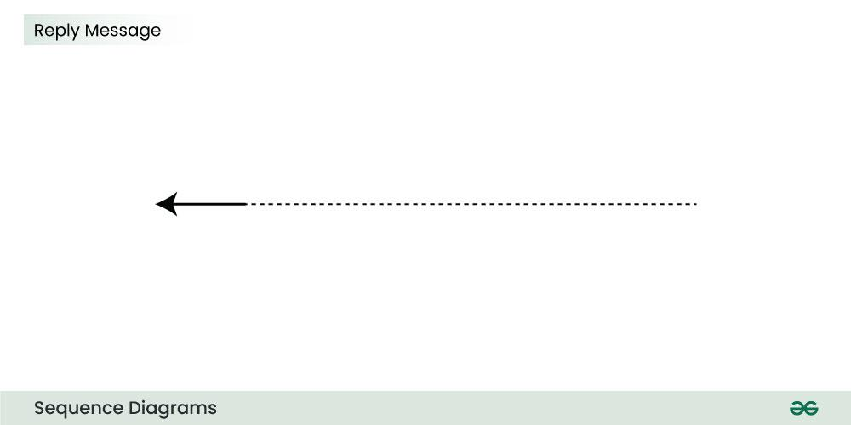
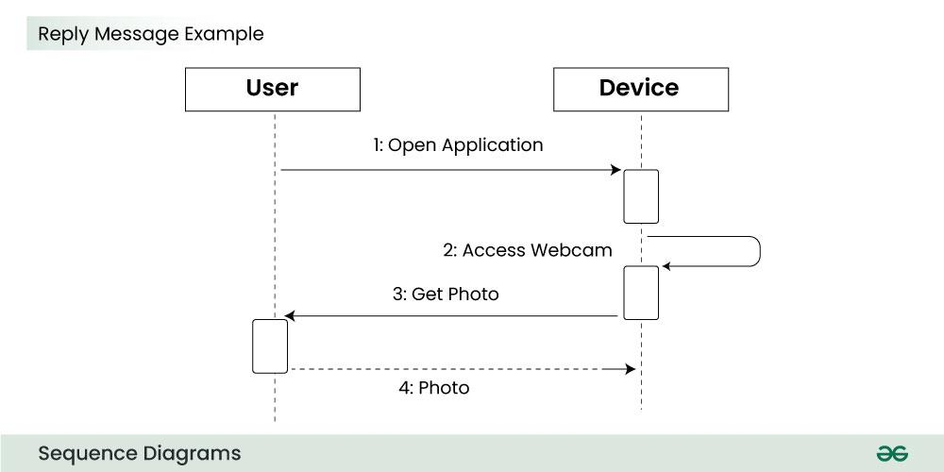
Sequence Diagram: Reply Message
1.7. Reply Message
Reply messages are used to show the message being sent from the receiver to the sender. We represent a return/reply message using an open arrow head with a dotted line. The interaction moves forward only when a reply message is sent by the receiver.
For example: Consider the scenario where the device requests a photo from the user.
Here the message which shows the photo being sent is a reply message.

Slide 40
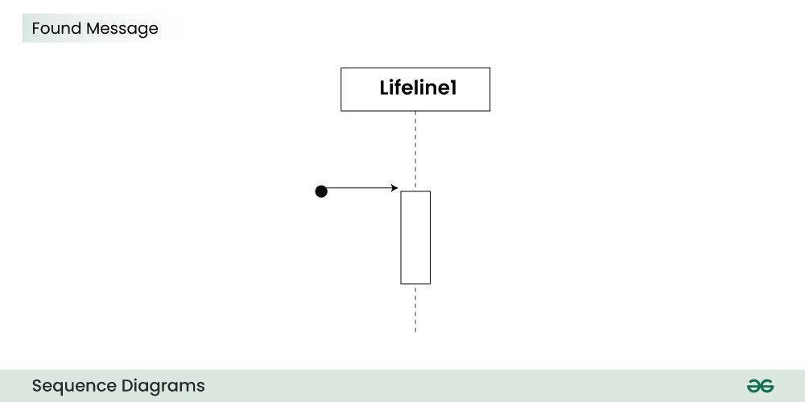
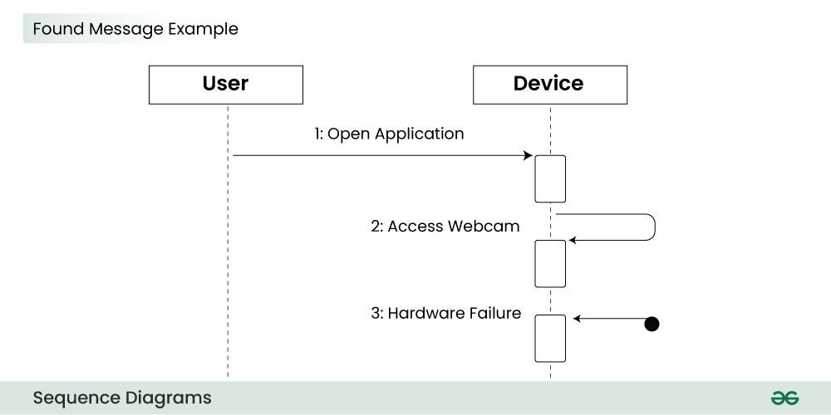
Sequence Diagram: Found Message
1.8. Found Message
A Found message is used to represent a scenario where an unknown source sends the message. It is represented using an arrow directed towards a lifeline from an end point.
For example: Consider the scenario of a hardware failure.
It can be due to multiple reasons and we are not certain as to what caused the hardware failure.

Slide 41
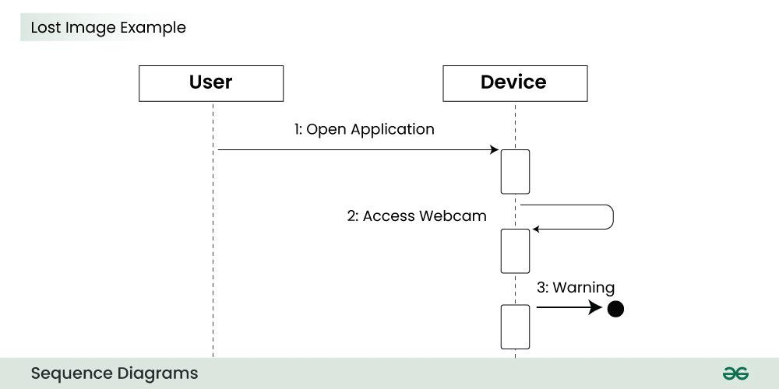
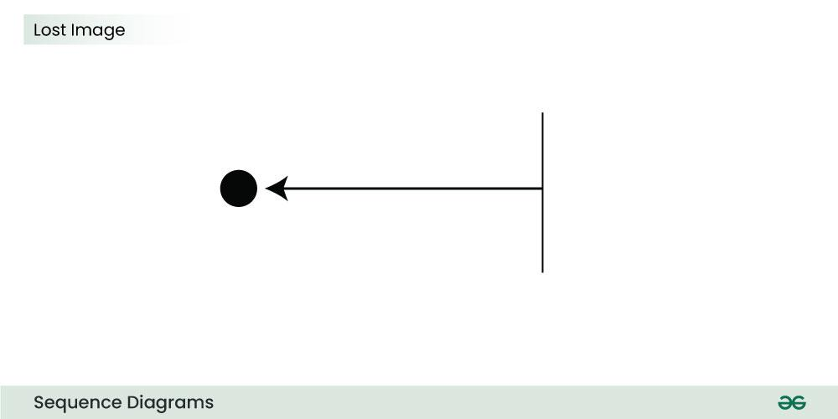
Sequence Diagram: Lost Message
1.9. Lost Message
A Lost message is used to represent a scenario where the recipient is not known to the system. It is represented using an arrow directed towards an end point from a lifeline.
For example: Consider a scenario where a warning is generated.
The warning might be generated for the user or other software/object that the lifeline is interacting with. Since the destination is not known before hand, we use the Lost Message symbol.

Slide 42
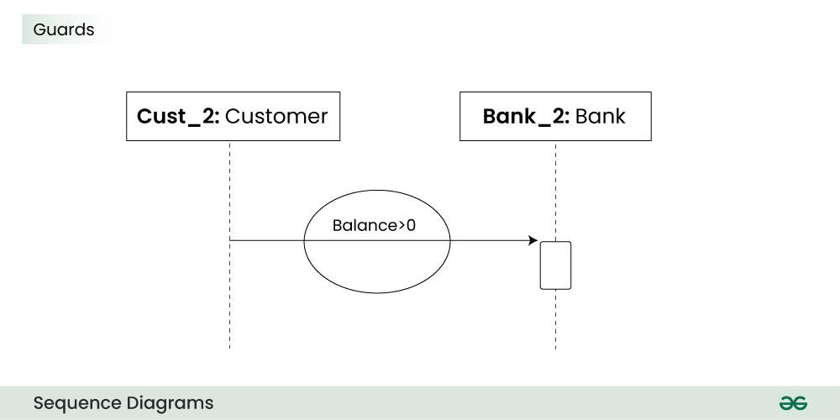
Sequence Diagram: Guards
1.10. Guards
To model conditions we use guards in UML. They are used when we need to restrict the flow of messages on the pretext of a condition being met. Guards play an important role in letting software developers know the constraints attached to a system or a particular process.
For example: In order to be able to withdraw cash, having a balance greater than zero is a condition that must be met as shown below.

Slide 43
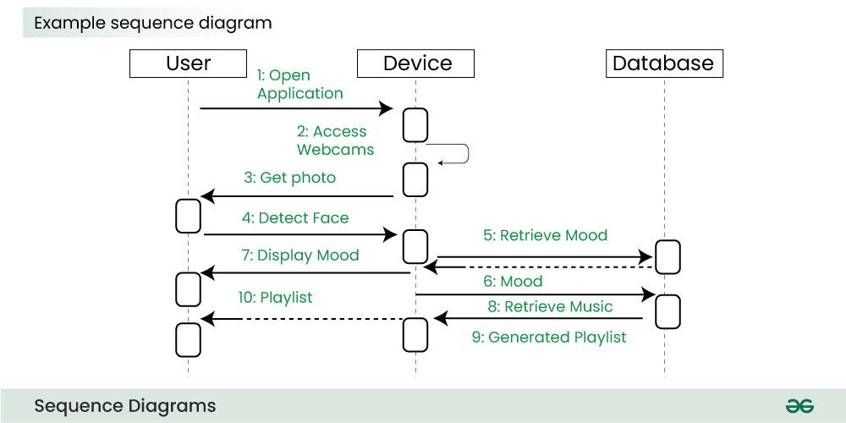
Sequence Diagram: Guards
1.10. Guards
The below sequence diagram depicts the sequence diagram for an emotion based music player:
Firstly the application is opened by the user.
The device then gets access to the web cam.
The webcam captures the image of the user.
The device uses algorithms to detect the face and predict the mood.
It then requests database for dictionary of possible moods.
The mood is retrieved from the database.
The mood is displayed to the user.
The music is requested from the database.
The playlist is generated and finally shown to the user.

Slide 44
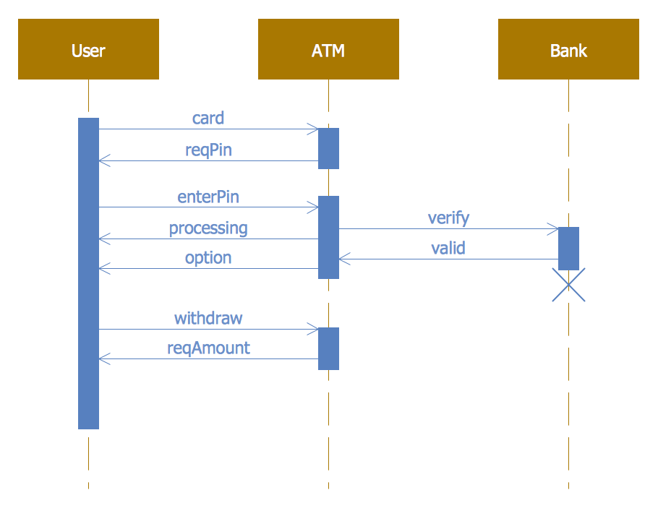
Sequence Diagram: Samples-> Bank Sequence Diagram
More samples: https://creately.com/guides/sequence-diagram-tutorial/

Slide 45
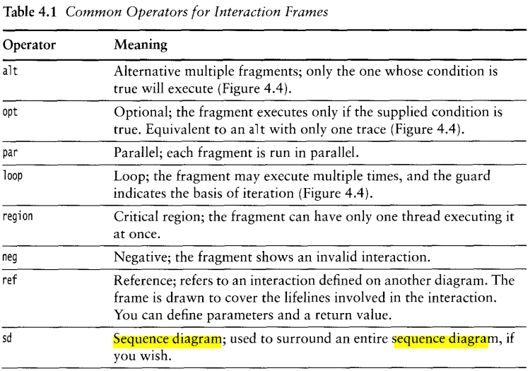
Sequence Diagram: Loops, Conditionals, and the Like
Both loops and conditionals use interaction frames, which are ways of marking off a piece of a sequence diagram .

Slide 46
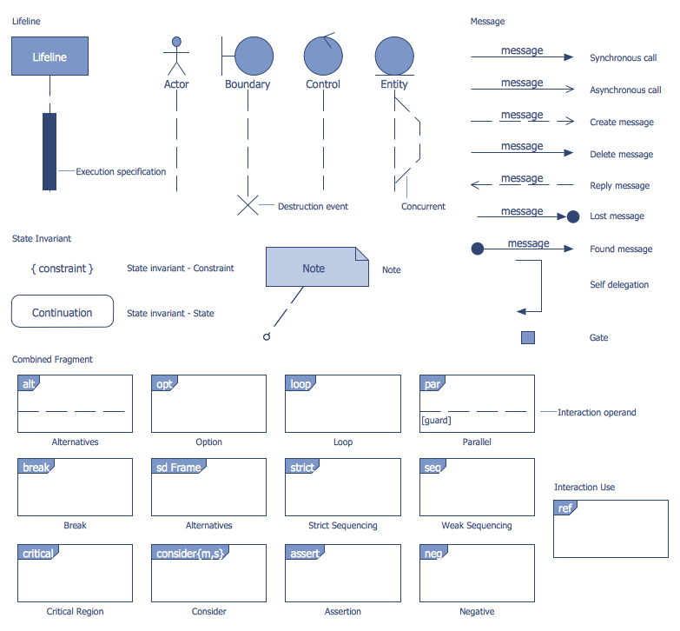
Design Elements- UML Sequence Diagram

Slide 47
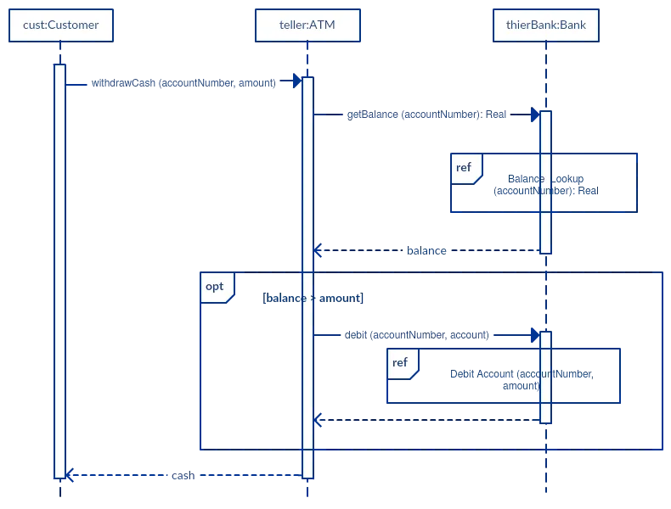
Sequence Diagram: Bank Sequence Diagram
https://creately.com/guides/sequence-diagram-tutorial/

Slide 48
State Machine Diagram
State machine diagrams are a familiar technique to describe the behavior of a System .
In object-oriented approaches, you draw a State machine diagram for a single class to show the lifetime behavior of a single object.

Slide 49
State Machine: Secret Panel
The diagram shows that the controller can be in three states : Wait, Lock, and Open.
Transition indicates a movement from one State to another
Label: trigger-signature [guard]/activity
The trigger-signature is usually a single event that triggers a potential change of State .
The guard, if present, is a Boolean condition that must be true for the transition to be taken .
The activity is some behavior that's executed during the transition.
Notes:
All three parts to a transition are optional.
A missing activity indicates that you don't do anything during the transition .
A missing guard indicates that you always take the transition if the event occurs .

Slide 50
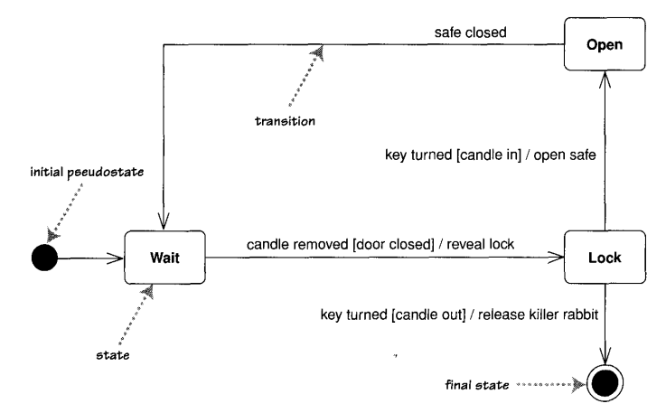
State Machine: Secret Panel
Wait: The State diagram Starts with the state of the controller object when it's created, the Wait State (Initial State).
Lock: To reveal the lock to the safe, remove a strategic candle from its holder, but this will reveal the lock only while the door is closed.
Open: When the lock is revealed, inserts the key to open the safe. For extra safety, make sure that The door can be opened the safe only if the candle is replaced firstly.
Final state: The final state indicates that the state machine is completed, implying the deletion of the controller object.
The killer rabbit is released when the key is turned while the candle is out.

Slide 51
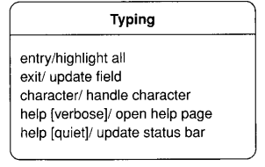
State Machine: Internal Activities
States can react to events without transition, using internal activities :
putting the event, guard, and activity inside the state box itself.
An internal activity is similar to a self-transition :
A transition that loops back to the same state.
The Syntax for internal activities follows the same logic for event, guard, and procedure.
shows a state with internal activities of the character and help events, as you might find an a UI text field .

Slide 52
State Machine: Activity States
In the states ,the object is quiet and waiting for the next event before it does something . However, you can have states in which the object is doing some ongoing work .
The ongoing activity is marked with the do/; hence the term do-activity .
Both do-activities and regular activities represent carrying out some behavior.
do-activity: In a State machine diagram in UML, the do-activity represents the specific actions that are performed while in a particular state. These actions are executed continuously while the state is active.
Regular activity: On the other hand, the regular activity represents the transitions between states and the conditions that trigger these transitions. It describes the flow of control between different states in the state machine diagram.
Overall, the do-activity focuses on the actions that occur within a state, while the regular activity focuses on the transitions between states. Both are important aspects of modeling the behavior of a system using a state machine diagram in UML.

Slide 53
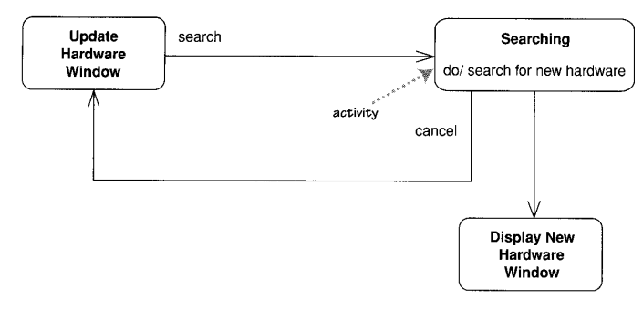
State Machine: Activity State-> Sample
Searching: Once the search is completed, any transitions without an activity, such as the one to display new hardware, are taken.
Update hardware Windows: If the cancel event occurs during the activity, the do-activity is unceremoniously halted, and we go back to the Update Hardware Window state.
Note: The critical difference between the two is that regular activities occur "instantaneously" and cannot be interrupted by regular events, while do-activities can take finite time and can be interrupted.

Slide 54
State Machine: Activity State-> Sample
State A -> [Regular Activity: Action 1] -> State B -> [Do-Activity: Action 2] -> State C
In this example, when the system transitions from State A to State B, it performs a regular activity which is "Action 1". Then, when the system transitions from State B to State C, it performs a do-activity which is "Action 2".
The regular activity is executed when the transition occurs, while the do-activity is executed upon entering the new state.

Slide 55
Machine State: Concurrent State
What: A concurrent state machine is a type of state machine that can execute multiple states simultaneously. This means that different parts of the machine can be in different states at the same time, allowing for more complex and parallel operations to be performed.
Why: Concurrent state machines are often used in software development and programming to manage multiple tasks and processes concurrently.
What: States can be broken into several orthogonal state diagrams that run concurrently.
Note: An orthogonal state in a state machine diagram refers to a situation where multiple states can occur simultaneously and independently of each other.

Slide 56
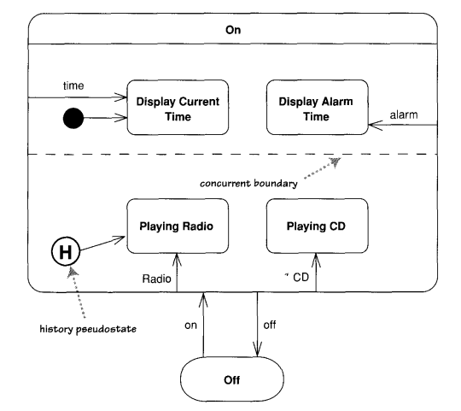
Machine State: Concurrent State-> Sample
This figure shows pathetically simple alarm dock that can play either CDs or the radio and show either the current time or the alarm time (There are two machine states) .
The choices CD/radio and current/alarm time are orthogonal choices .
history pseudostate: This indicates that when the clock is switched on, the radio/CD choice goes back to the state the clock was in when it was turned off.
4. The arrow from the history pseudostate indicates what state to be in an the first time when there is no history .

Slide 57
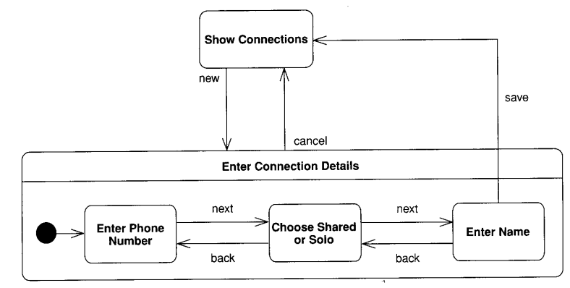
State Machine: Superstates
What: Superstates in a machine state diagram represent a grouping of multiple individual states that share common characteristics or functionalities.
Why: Often, you'll find that several states share common transitions and internal activities
By grouping states together into a superstate, the diagram can become more organized and easier to understand. Without the superstate, you would have to draw cancel transition for all three states within the Enter Connection Details state.
How: Move the states with shared behavior into a superstate.
In this figure There are four states.
Superstate: Enter connection Details Sate that contains and three states :
Enter Phone Number
Choose Shared or Solo
Enter Name
Note: Enter phone Number is the first state when the
machine state goes to the Enter Connection Details state.
Superstate with nested substates

Slide 58
State Machine: Superstates -> Sample
An example of a superstate in a machine state diagram could be a "Ready" superstate that includes substates such as "Start" and "Paused".
The "Ready" superstate may represent the overall readiness of a system, with "Start" and "Paused" representing specific states within that readiness.
Here is an example of how it could look in a machine state diagram:
Superstate: Ready
Substate: Start
Substate: Paused
In this example, the "Ready" superstate encompasses the "Start" and "Paused" substates, reflecting the different operational states.
Note:
Superstates can be included in a state machine diagram. Superstates are composed of multiple substates and allow for a more organized and hierarchical representation of the system's behavior. They help in simplifying and managing complex state transitions in a more structured manner.

Slide 59
UML: Component Diagram
Component Diagrams illustrate how components are put together to form larger components or software systems and illustrate the architecture of software components and dependencies between them.
This software components can include :
Runtime components
Executable components
Source code components

Slide 60
UML: Deployment Diagram
Deployment diagram helps to model the physical aspect of an object-oriented software system.
This is a block diagram that shows the system architecture as deployment or distribution of software artifacts.
Artifacts represent specific elements in the physical world that are the result of the development process.
The diagram simulates the run time configuration in a static view and visualize the distribution of artifacts in the application. In most cases this involves simulating hardware configurations along with the software components that host them.

